Slide 2
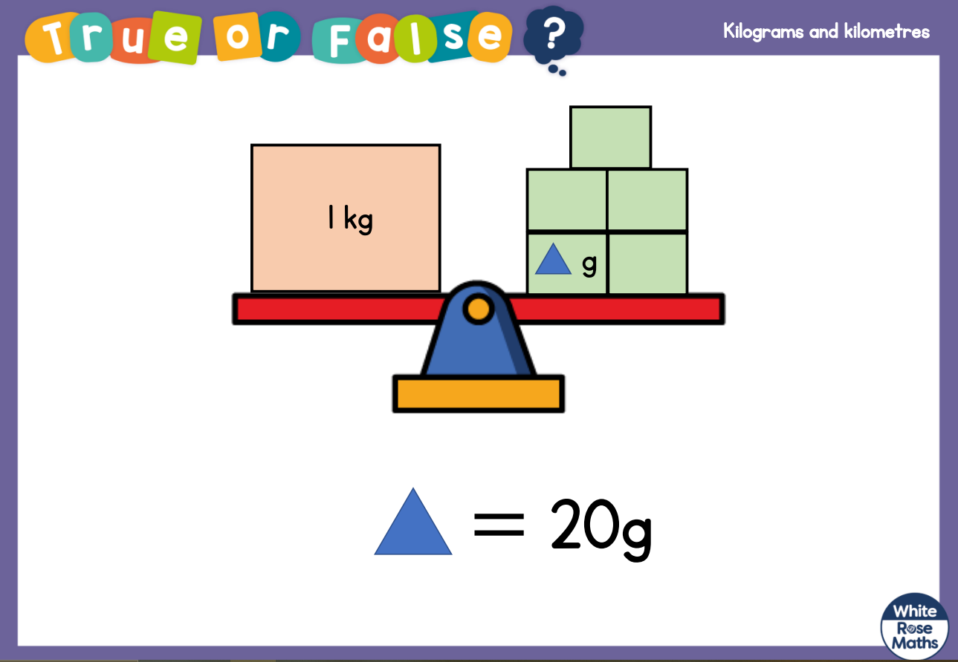

Slide 3
1) metres = 3 km
2)
3) 0.7 + 0.5 =
4) = 0.1
= 0.
$$\frac{\text{1}}{\text{5}}$$
$$\text{0}$$
$$\text{1}$$
$$\frac{\text{1}}{\text{10}}$$
$$\frac{\text{1}}{\text{20}}$$

Slide 4
1) metres = 3 km
2)
3) 0.7 + 0.5 =
4) = 0.1
= 0.
3,000
$$\frac{\text{1}}{\text{5}}$$
$$\frac{\text{2}}{\text{5}}$$
$$\frac{\text{3}}{\text{5}}$$
$$\frac{\text{4}}{\text{5}}$$
$$\text{0}$$
$$\text{1}$$
1.2
$$\frac{\text{1}}{\text{10}}$$
$$\frac{\text{1}}{\text{20}}$$
05

Slide 6
kilograms
0
1
2
3
4
5
6
7
8
9
10
0
1,000
2,000
3,000
4,000
5,000
6,000
7,000
8,000
9,000
10,000
grams
10 kg = 10,000 g
5 kg = 5,000 g
6 kg = 6,000 g
7 kg = 7,000 g
8 kg = 8,000 g
9 kg = 9,000 g
1 kg = 1,000 g
2 kg = 2,000 g
3 kg = 3,000 g
4 kg = 4,000 g
0 kg = 0 g

Slide 7
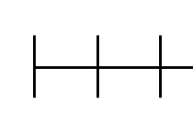
kilograms
0.5
0
?
1
0
500
1,000
grams
?

Slide 8
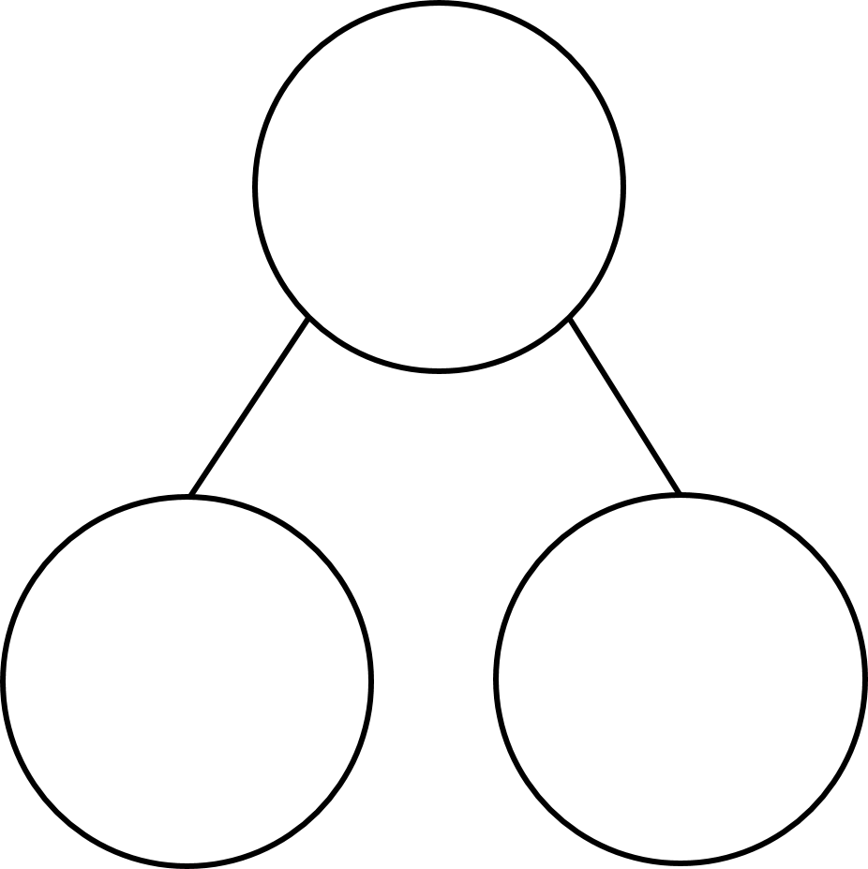
15.5 kg
Have a think
15,000 g
15 kg
0.5 kg
500 g
kilograms
15
15.5
16
15,000
15,500
16,000
?
grams

Slide 9
23.2 kg =
23,200
g
Have a think
kilograms
23
23.1
23.2
23.3
23.4
23.5
23,000
23,100
23,200
23,300
23,400
23,500
grams

Slide 10
500
$$\frac{\text{1}}{\text{2}} \text{km}$$
$$\text{m}$$
=
kilometres
$$\frac{\text{1}}{\text{2}}$$
0
1
0
500
1,000
metres

Slide 11
Have a think
$$\frac{\text{2}}{\text{5}} \text{kg}$$
=
400
$$\text{g}$$
kilograms
$$\frac{\text{1}}{\text{5}}$$
$$\frac{\text{2}}{\text{5}}$$
$$\frac{\text{3}}{\text{5}}$$
$$\frac{\text{4}}{\text{5}}$$
0
1
0
200
400
600
800
1,000
grams
1,000 ÷ 5 =
200

Slide 12
Have a think
$$\frac{\text{34}}{\text{68}} \text{kg}$$
$$=$$
500
$$\text{g}$$
$$\frac{\text{1}}{\text{2}}$$

Slide 13
kilometres
0
0.1
0.2
0.3
0.4
0.5
0.6
0.7
0.8
0.9
1
0
100
200
300
400
500
600
700
800
900
1,000
metres
$$\frac{\text{7}}{\text{10}} \text{km}$$
=
1
1
$$\text{km}$$
400 m +
$$\text{.}$$
0.4 km +
0.7 km
1.1
=

Slide 14
Onions cost 9p per 100 g
Jack buys 2.1 kg of onions.
How much money does Jack spend?
£1.89
2.1 kg = 2,100 g
2,100 g ÷ 100 g =
21
21 × 10 =
210
21 × 9 =
189
210 – 21 =
189

Slide 15
Mo cycles 300 m in 1 minute.
How long does it take Mo to cycle 6 km?
20 minutes
Have a think
6 km = 6,000 m
300 × 2 =
600
1 minute for 300 m
× 20
× 20
20
___ minutes for 6,000 m

Slide 19
