Slide 1
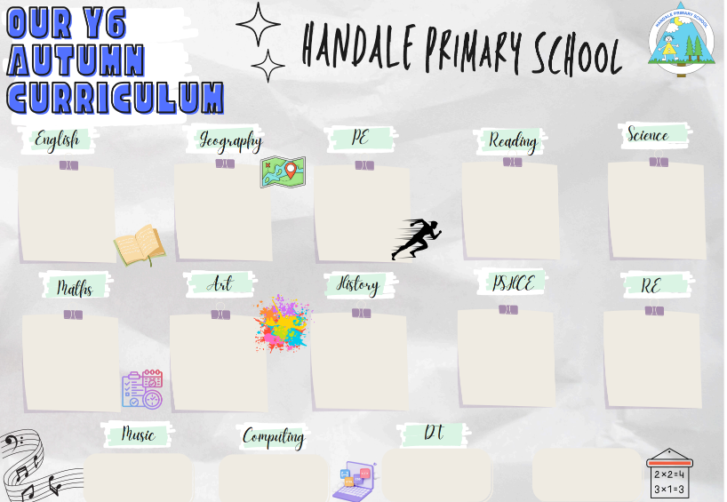
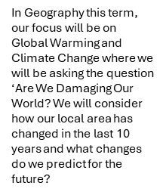
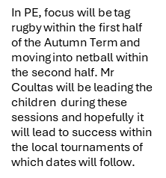
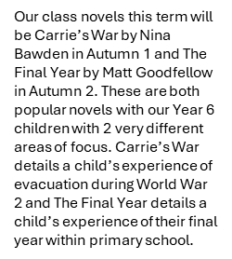
In the first half of the Autumn Term we will focusing our narrative on Carrie’s War by Nina Bawden. Our non-fiction will a non-chronological report where our area of focus will be Britain at War and our reports will detail the Blitz and evacuated children. In Autumn 2 our narrative focus will be on the book The Final Year by Matt Goodfellow.
We will be studying Evolution and Inheritance in Science within the first half of this term where we will be delving into the work and studies of Charles Darwin. This will be followed by the focus Animals Including Humans within the second half of the term. Both topics have their basis in biology and the links will be closely scrutinised.
Our maths journey starts with Place Value where were will be looking at numbers up to 10,000,000. Order of Operations comes next with multiplication and division following in which we also look at unit conversion and statistics.
In Art we will be looking at Drawing where will be considering different artists within this field and attempting to work on our skills in creating shadows, reflections and negative spaces plus also depicting movement and perspective using different materials.
Britian at War is our history focus this term where will be looking at and investigating World War 2 and asking why Britain went to war, the role of women, evacuation of children, what life was like on the battlefield, Adolf Hitler and The Holocaust. Quite a journey.
Our PSHCE focus in Autumn will consider Being Me In The World which will start with considering our hopes and fears for the coming year. This will be followed in Autumn 2 by Celebrating Differences and considering how we differ and how we should celebrate this.
In RE we will be looking at Islam and asking ‘What is the best way for a Muslim to show their commitment to God? We will consider the 5 Pillars of Islam and consider the level of commitment these require and how they may impact the life of a Muslim.
In DT we will be considering the digital world and looking at how our DT skills can help us navigate that world and how it could develop into a career if we chose it.
Please read with / encourage your child to read at home at least 3 times a week. The benefits of this are outstanding. These benefits are seen daily within the classroom.
In music we are excited to be bringing Sing Education into school They will be delivering fun and exciting music lessons throughout the year.
In Computing we will be looking at publishing and looking at what an e-book is. We will then take on the challenge of creating one of our own.

